Slide 1
FINANCIAL METRICS AND SHAREHOLDERS VALUE IN LISTED CONSUMER GOODS MANUFACTURING FIRMS IN NIGERIA
HACKERTON PROJECT ON DATA ANALYSIS
GROUP 6

Slide 2
Introduction
Definition of Financial Metrics:
Financial metrics are quantifiable measures used to evaluate and track the financial performance, health, and efficiency of a company. These metrics include various ratios, values, and indicators derived from a company's financial statements, such as the balance sheet, income statement, and cash flow statement. Common financial metrics include Earnings Per Share (EPS), Return on Equity (ROE), Market Value of Shares (MVS), Net Value of Shares (NVS), Cost of Debt (COD), and Economic Value Added (EVA).

Slide 3
Objectives
The main objective of the study is to assess the effect of financial metrics on Shareholder Value in listed Consumer Goods Manufacturing Firms in Nigeria. The specific objectives are to:
evaluating the effects of financial metrics on the Market value of shares (MVS) in listed Consumer Goods Manufacturing Firms in Nigeria.
determine the effects of financial metrics on the Net Value per share value (NVS) of investors in listed Consumer Goods Manufacturing Firms in Nigeria.
assess the effects of financial metrics on the cost of debt (COD) in listed Consumer Goods Manufacturing Firms in Nigeria

Slide 4
Research Hypotheses
H₀₁: Financial metric has no significant effect on the market value of shares in listed Consumer Goods Manufacturing Firms in Nigeria.
H₀₂: Financial metric has no significant effect on the nominal value of shares in listed Consumer Goods Manufacturing Firms in Nigeria.
H₀₃: Financial metric has no significant effect on the cost of debt in listed Consumer Goods Manufacturing Firms in Nigeria.

Slide 5
Definition of Metrics used
MVS (Market Value per Share): The current price at which a company's share is traded on the stock market.
NVS (Net Value per Share): The net asset value of a company divided by the number of outstanding shares.
COD (Cost of Debt): The effective rate that a company pays on its borrowed funds.
EPS (Earnings per Share): The portion of a company's profit allocated to each outstanding share of common stock.
EVA (Economic Value Added): A measure of a company's financial performance that shows the net profit after deducting the cost of capital.
MVA (Market Value Added): The difference between the market value of a company and the capital contributed by investors.
No of Shares (Number of Shares Outstanding): The total number of a company's shares that are currently owned by all its shareholders.
Interest: The cost incurred by a company for borrowed funds.
Total Debt: The sum of all short-term and long-term liabilities of a company.
Capital Employed: The total amount of capital used for the acquisition of profits, calculated as total assets minus current liabilities.
Market Value: The total market capitalization of a company, calculated as the current share price multiplied by the total number of outstanding shares.
WACC (Weighted Average Cost of Capital): The average rate of return a company is expected to pay its security holders to finance its assets.
NOPAT (Net Operating Profit After Tax): A company's potential cash earnings if it had no debt.
COE (Cost of Equity): The return a firm theoretically pays to its equity investors to compensate for the risk they undertake by investing their capital.
Capital Charge: The cost of capital for a company, calculated as the capital employed multiplied by the WACC.

Slide 6
Methodology Overview
Data Collection:
Sources: Annual financial reports
Firms: Dangote, Unilever, Nestle, PZ Cussons, Cadbury, Vitafoam, Flour, BUA, Nigerian Breweries, Union Dicon
Key Metrics: Market Value per Share (MVS), Net Value per Share (NVS), Cost of Debt (COD)
Data Processing & Analysis:
Initial Processing:
Tool: Microsoft Excel
Tasks: Data cleaning, organization, preliminary visualizations
Advanced Analysis:
Tool: Python
Libraries: Pandas, NumPy, SciPy, Matplotlib, Seaborn
Techniques: Descriptive statistics, correlation analysis, regression analysis
Exploratory & Regression Analysis:
Tool: Microsoft Excel
Tasks: Exploratory data analysis, regression modeling
Interactive Visualization & Reporting:
Tool: Power BI
Tasks: Development of interactive dashboards and comprehensive reports for dynamic data exploration
Hypothesis Testing:
Tools: Python & Excel
Methods: Statistical tests to validate hypotheses

Slide 7
Research Questions One How do financial metrics affect the market value of shares in listed Consumer Goods Manufacturing Firms in Nigeria?
Table 1.2 ANOVA
 | df | SS | MS | F | Significance F
Regression | 12 | 11448555.1 | 954046.258 | 38.7749476 | 2.717E-31
Residual | 100 | 4217949.92 | 42179.4992
Total | 112 | 15666505
ANOVA (Table 1.2)
F-Statistic: 38.77 – This value tests the overall significance of the model. A high F-value indicates that at least one of the predictors significantly explains the variance in the market value of shares.
Significance F: 2.717E-31 – This very small p-value (less than 0.05) indicates that the model is statistically significant and that the predictors collectively have a significant effect on the market value of shares.
Decision rule
For H01, the null hypothesis is rejected because the overall p-value for the market value regression model is significantly less than 0.05, indicating that financial metrics have a significant effect on the market value of shares.

Slide 8
Research Question Two What is the impact of financial metrics on the nominal share value of investors in listed Consumer Goods Manufacturing Firms in Nigeria?
Table 1.5 ANOVA
 | df | SS | MS | F | Significance F
Regression | 12 | 105607.417 | 8800.61812 | 46.5435756 | 2.0891E-34
Residual | 100 | 32414.2993 | 324.142993
Total | 112 | 138021.717
ANOVA (Table 1.5)
F-Statistic: 46.54 – This high value indicates that the regression model significantly explains the variance in the nominal share value.
Significance F: 2.0891E-34 – The very low p-value confirms that the overall model is statistically significant, indicating that the financial metrics collectively have a meaningful impact on the nominal share value.
Decision rule
For H02, the null hypothesis is rejected because the overall p-value for the nominal value regression model is significantly less than 0.05, indicating that financial metrics have a significant effect on the nominal value of shares.

Slide 9
Research Question three How do financial metrics influence the cost of debt in listed Consumer Goods Manufacturing Firms in Nigeria?
Table 1.8 ANOVA
 | df | SS | MS | F | Significance F
Regression | 12 | 129.741614 | 10.8118011 | 4.55724052 | 8.9593E-06
Residual | 100 | 406.704806 | 4.06704806
Total | 112 | 536.44642
ANOVA (Table 1.8)
Significance F: 8.9593E-06
The p-value for the F-test is much less than the significance level (0.05), indicating that the overall regression model is statistically significant. This suggests that at least some of the financial metrics have a meaningful effect on the cost of debt.
Decision Rule
Reject the Null Hypothesis because the p-value is significantly smaller than the significance level.

Slide 10
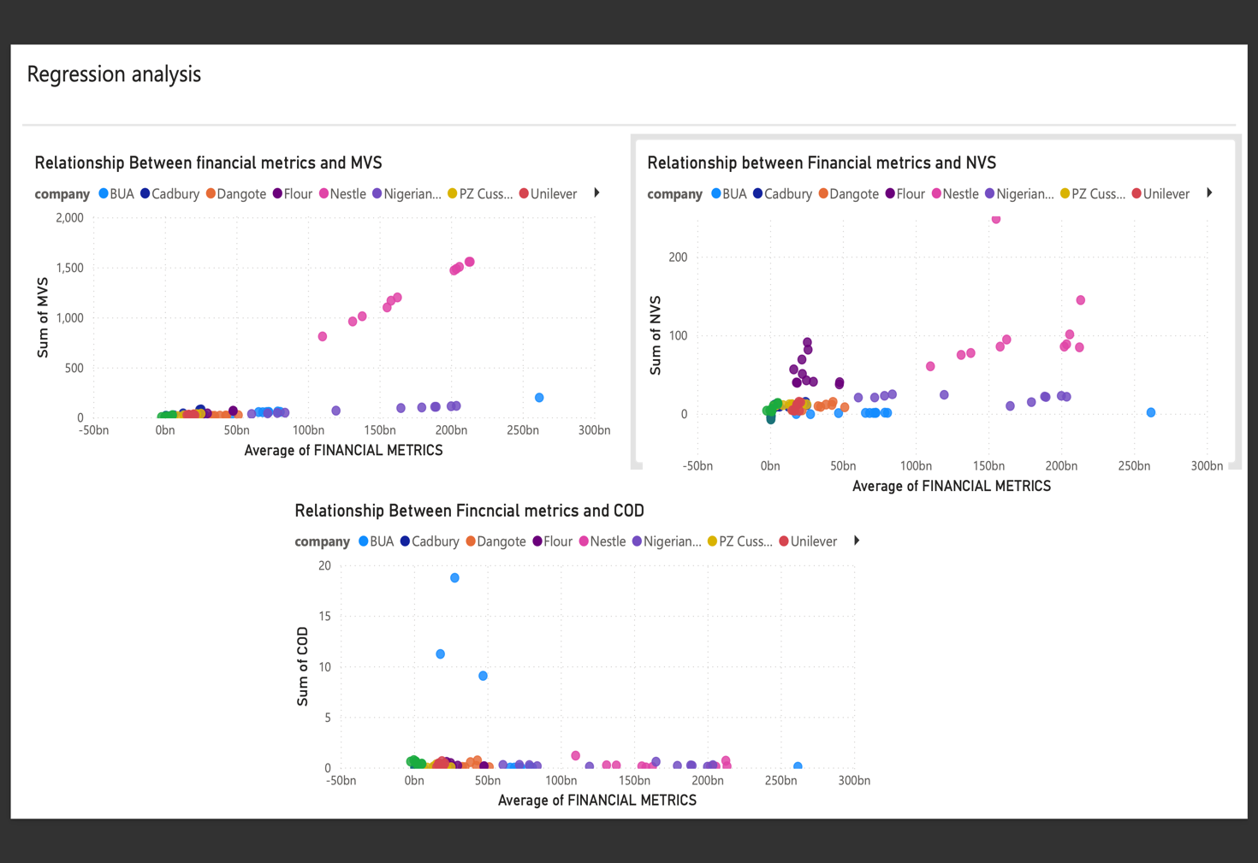
The below dash board shows the interaction effect between all the dependent variables and independent variables

Slide 11
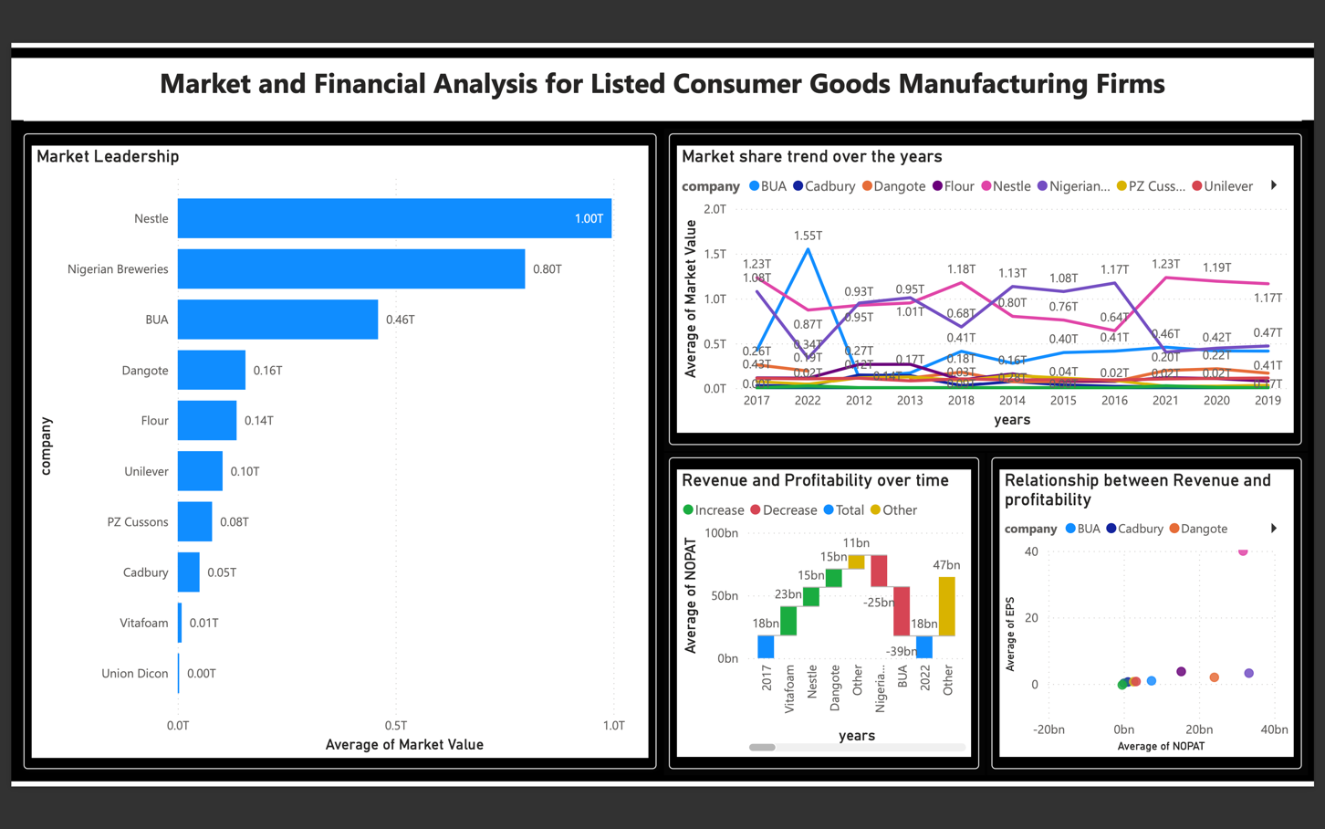
Market and financial analysis for Listed consumer goods manufacturing firms

Slide 12
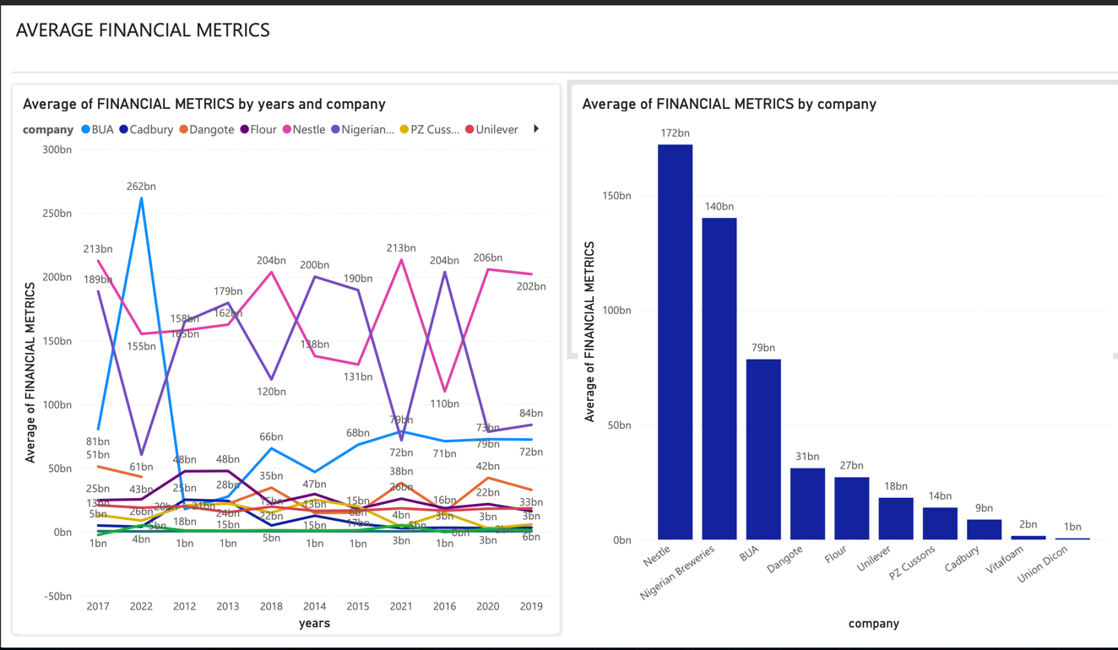
Average Financial Metrics

Slide 13
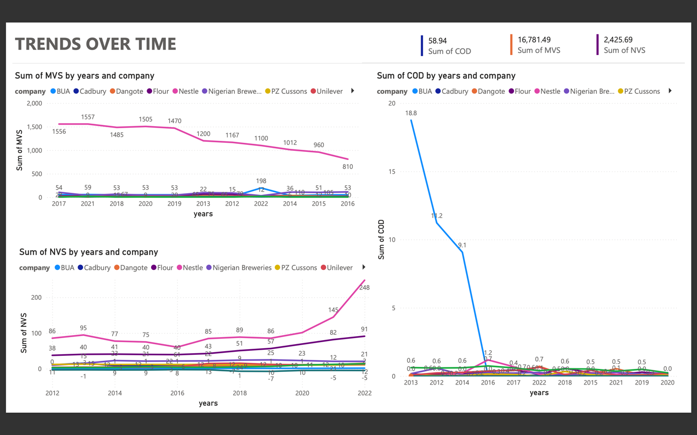
Trends over time

Slide 14
Summary
The analysis reveals that financial metrics significantly influence the Market Value of Shares (MVS) and Nominal Share Value (NVS), with the null hypotheses (H01 and H02) rejected based on strong statistical significance (R-squared values of 73.08% and 76.52%, respectively).
For the Cost of Debt (COD), the effect is more moderate, with only NOPAT being a significant predictor and an R-squared value of 24.19%, leading to the rejection of the null hypothesis (H03). Overall, financial metrics have a substantial impact on MVS and NVS, while their effect on COD is less pronounced.

Slide 15
Recommendations
Based on the results, The following recommendations were made
Company Management and Financial Teams:
Enhancing Financial Metrics Tracking: Senior financial officers and management teams should integrate comprehensive financial metrics into their regular reporting to better assess the impact on market value, nominal share value, and cost of debt.
Strategic Financial Planning: The management teams should review and adjust their financial strategies based on the insights from the analysis. This includes prioritizing financial metrics that have shown significant effects on shareholder value and cost of debt.
Investors and Shareholders:
Investment Decisions: Investors should use the insights from the analysis to make informed investment decisions, focusing on companies with strong financial metrics and stable performance trends.
Engagement with Management: Shareholders can engage with company management to understand how the company plans to address the identified financial issues and to advocate for strategic changes based on the analysis.

